Slide 1
Correlation and Convolution They replace the value of an image pixel with a combination of its neighbors
Basic operations in images
Shift Invariant
Linear
Thanks to David Jacobs for the use of some slides

Slide 2
Consider 1D images
I = [ 5 4 2 3 7 4 6 5 3 6 ]
so I(1)=5, I(2)=4, and so on.
Consider a simple averaging operation, in which we replace every pixel in a 1D image by the average of that pixel and its two neighbors, and we produce a new image J. So, J(3) = (I(2)+I(3)+I(4))/3 =(4+2+3)/3=3.
How to deal with boundaries? What is the left neighbor of 5?
(a) [.. 0 0 0 5 4 2 3 7 4 6 5 3 6 0 0 ..] padded with zeros
[.. 5 5 5 5 4 2 3 7 4 6 5 3 6 6 6 ..] padded with 1st and last value
[.. 5 3 6 5 4 2 3 7 4 6 5 3 6 5 4 ..] image repeated cyclic

Slide 3
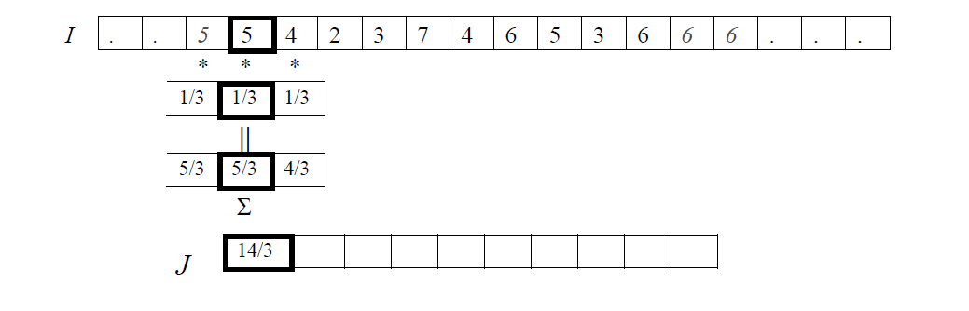
Correlation: a sliding operation in a window

Slide 4
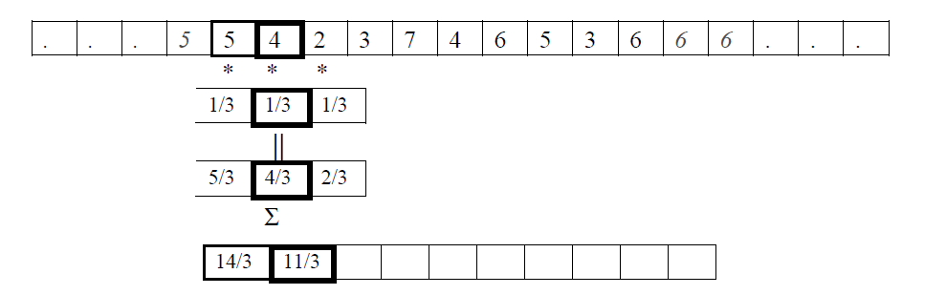
Continue with next pixel

Slide 5
Filters
The numbers we multiply with, i.e. (1/3,1/3,1/3) form a filter. This filter is 3 pixels wide.
We could build a filter for averaging that includes a pixel, its neighbors and their neighbors. This filter would be (1/5,1/5,1/5,1/5,1/5) and would be 5 pixels wide. These are “box” filters.
We place the filter on the image, multiply the contents of every cell with the pixel below and add up the results.
For this filter, the new image would be
J(1) = (I(-1)/5 + I(0)/5 + I(1)/5 + I(2)/5 + I(3)/5) = 1+1+1+4/5 + 2/5 = 4 1/5.

Slide 6
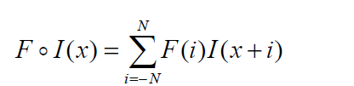
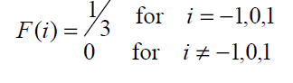
Mathematical Definition
Suppose F is a correlation filter. It will be convenient notationally to suppose that F has an odd number of elements, so we can suppose that as it shifts, its center is right on top of an element of I. So we say that F has 2N+1 elements, and that these are indexed from -N to N, so that the center element of F is F(0).

Slide 7
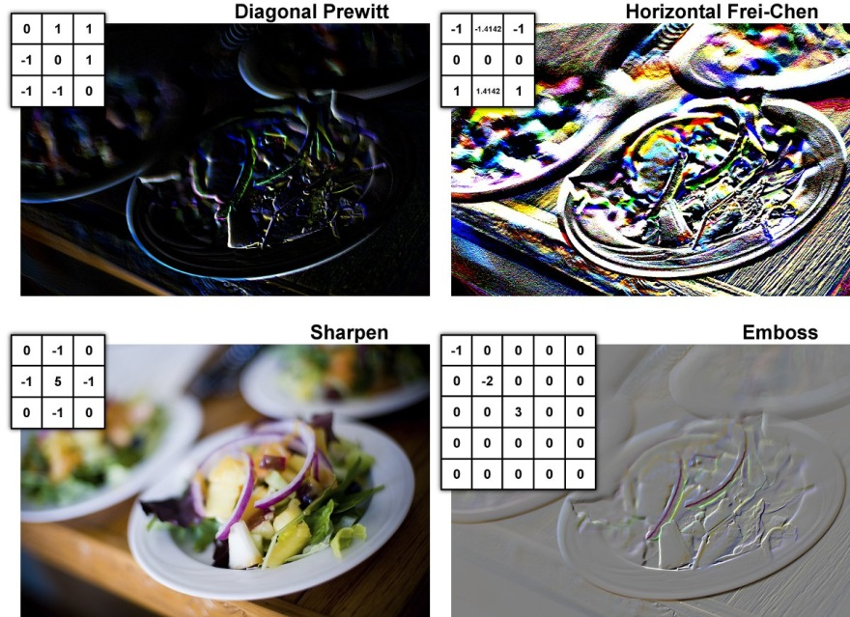
Examples in 2D

Slide 8
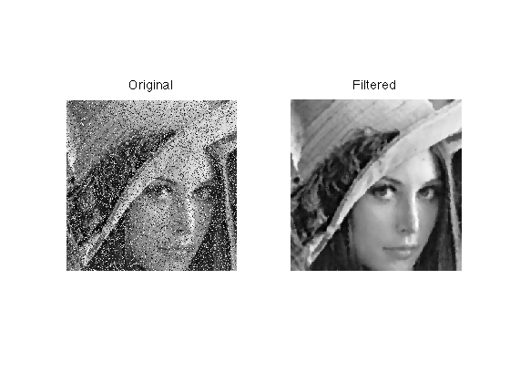

Slide 9
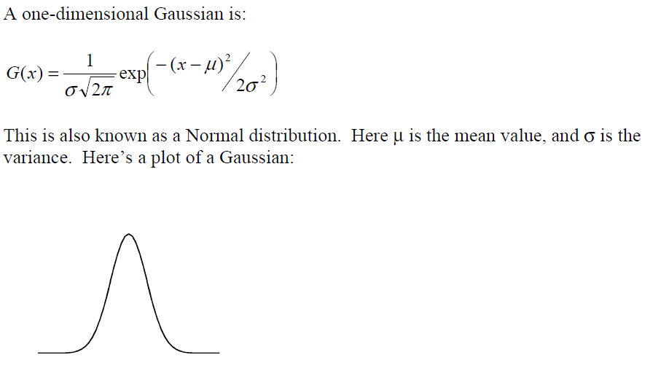
Making filters from continuous functions

Slide 10
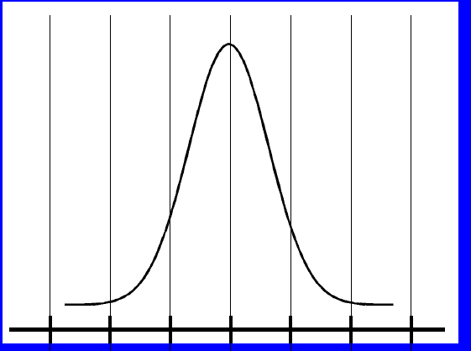
We would need to evaluate the Gaussian G at points (…,-3,-2,-1,0,1,2,3,..).
Luckily G(x) tends to zero pretty quickly as x gets larger.

Slide 11
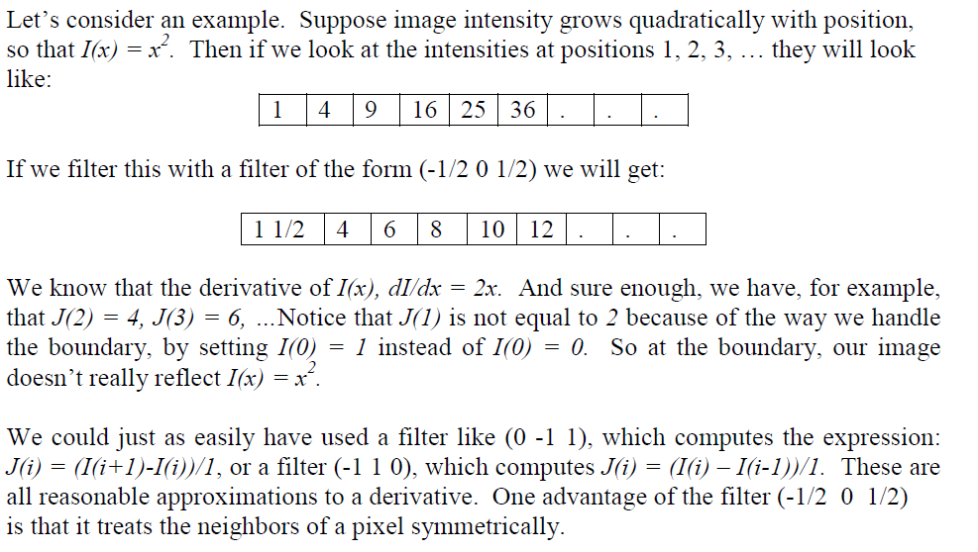
Taking derivatives with filters

Slide 12
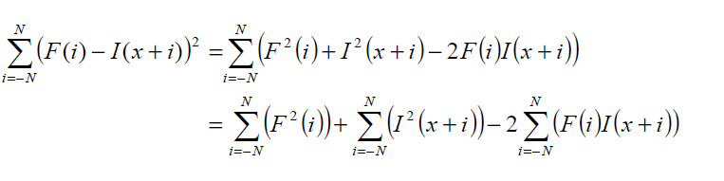
Matching with correlation
Matching the filter with part of the image – their difference depends on 3 terms: the higher the correlation the better the match

Slide 13
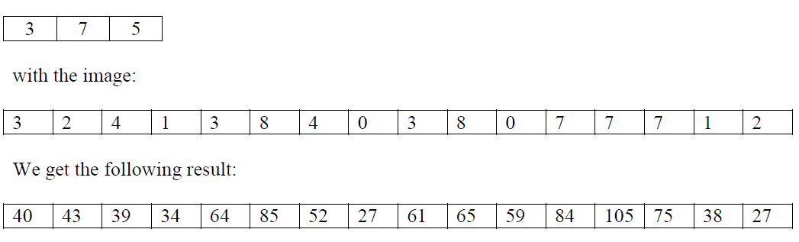
Weaknesses of correlation
Suppose we correlate the filter:
Notice that we get a high result (85) when we center the filter on the sixth pixel, because (3,7,5) matches very well with (3,8,4). But, the highest correlation occurs at the 13th pixel, where the filter is matched to (7,7,7). Even though this is not as similar to (3,7,5), its magnitude is greater.

Slide 14
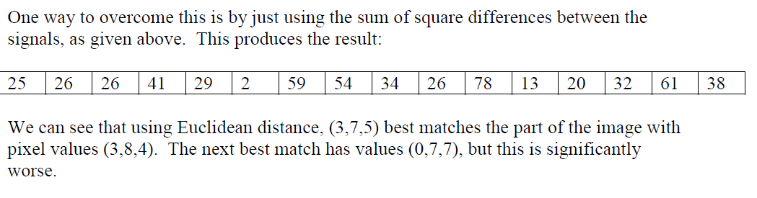
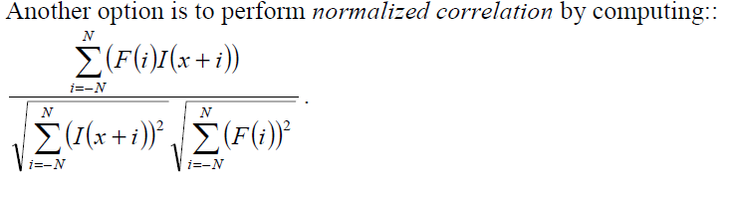
Matching

Slide 15
Normalized correlation
When we perform normalized correlation between (3,7,5) and the image I we get image J:
Now, the region of the image that best matches the filter is (3,8,4). However, we also get a very good match between (3,7,5) and end of the image, which, when we replicate the last pixel at the boundary, is (1,2,2). These are actually quite similar, up to a scale factor. Keep in mind that normalized correlation would say that (3,6,6) and (1,2,2) match perfectly. Normalized correlation is particularly useful when some effect, such as changes in lighting or the camera response, might scale the intensities in the image by an unknown factor.

Slide 16
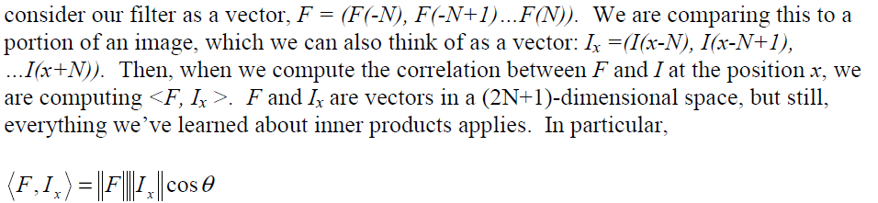
Correlation as an inner product

Slide 17
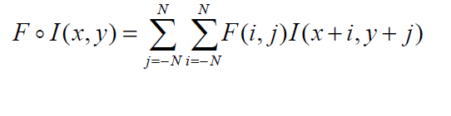
2D correlation

Slide 18
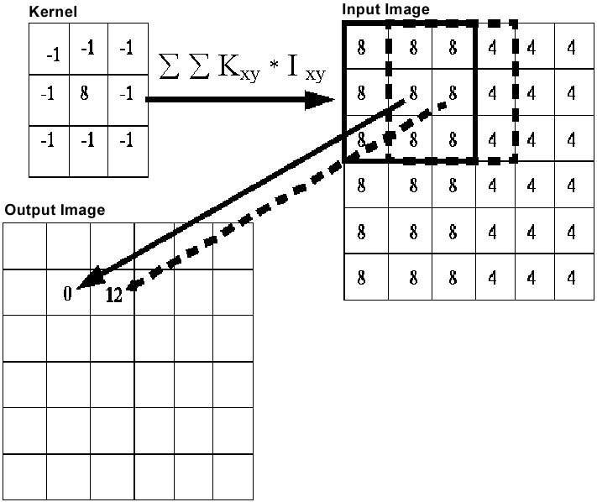
Examples

Slide 19

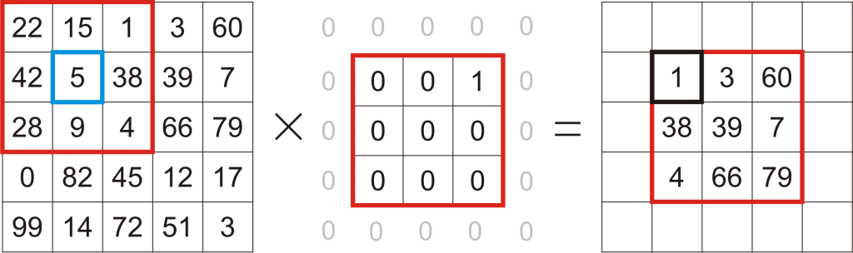
Examples

Slide 20
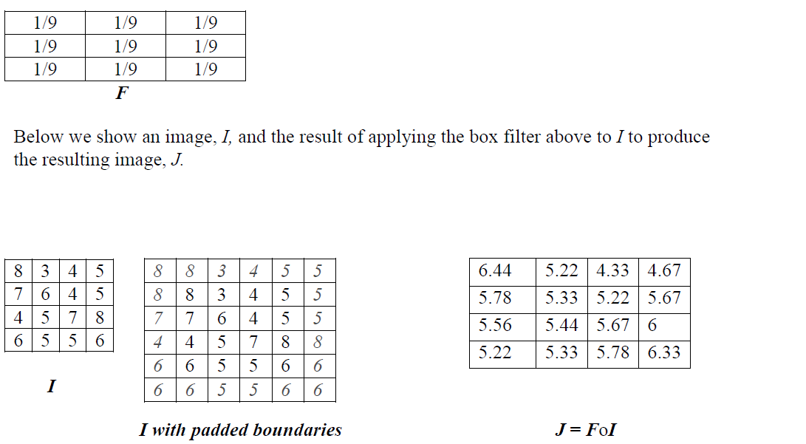
Example

Slide 21
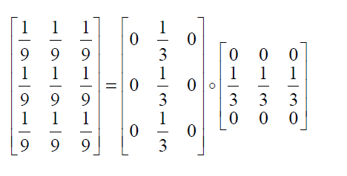
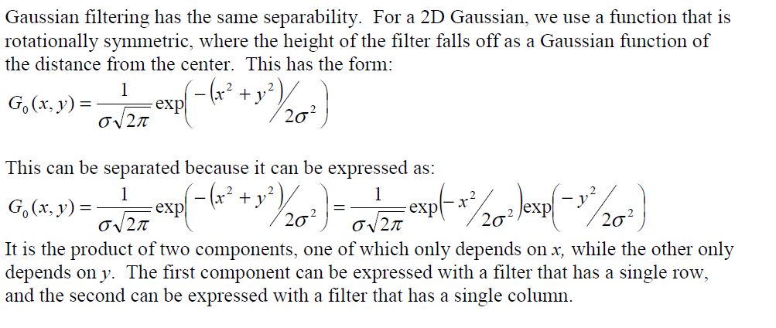
Separable filters

Slide 22
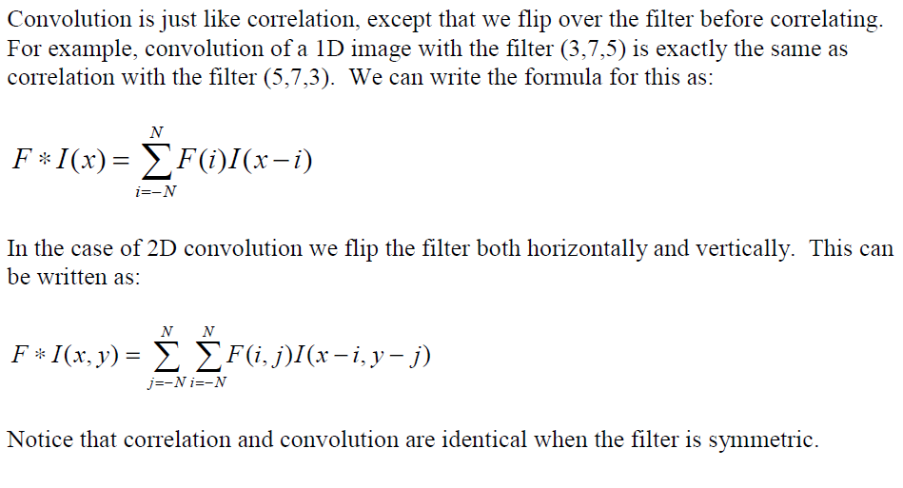
Convolution

Slide 23
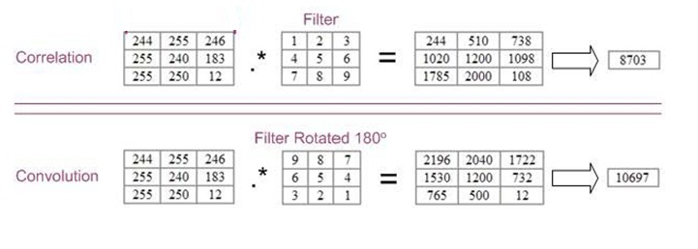
Example

Slide 24
Correlation - Convolution
Convolution is associative (F*G)*H=F*(G*H)
This is very convenient in filtering. If D is a derivative filter and G a smoothing filter then if I is the image: D*(G*I)= (D*G)*I
Correlation is not associative – it is mostly used in matching, where we do not need to combine different filters.

Slide 25
Dealing with Noise
(other presentation)

Slide 26
Noise
Image processing is
useful for noise
reduction...
Common types of noise:
Salt and pepper noise: contains random occurrences of black and white pixels
Impulse noise: contains random occurrences of white pixels
Gaussian noise: variations in intensity drawn from a Gaussian normal distribution
Notes:
Salt and pepper and impulse noise can be due to transmission errors (e.g., from deep space probe), dead CCD pixels, specks on lens
We’re going to focus on Gaussian noise first.
If you had a sensor that was a little noisy and measuring the same thing over and over, how would you reduce the noise?

Slide 27
Additive noise
We often assume the noise is additive
I = S + N. Noise doesn’t depend on signal.
We’ll consider:

Slide 28
Practical noise reduction
How can we “smooth” away noise in a single image?
0 | 0 | 0 | 0 | 0 | 0 | 0 | 0 | 0 | 0
0 | 0 | 0 | 0 | 0 | 0 | 0 | 0 | 0 | 0
0 | 0 | 0 | 100 | 130 | 110 | 120 | 110 | 0 | 0
0 | 0 | 0 | 110 | 90 | 100 | 90 | 100 | 0 | 0
0 | 0 | 0 | 130 | 100 | 90 | 130 | 110 | 0 | 0
0 | 0 | 0 | 120 | 100 | 130 | 110 | 120 | 0 | 0
0 | 0 | 0 | 90 | 110 | 80 | 120 | 100 | 0 | 0
0 | 0 | 0 | 0 | 0 | 0 | 0 | 0 | 0 | 0
0 | 0 | 0 | 0 | 0 | 0 | 0 | 0 | 0 | 0
0 | 0 | 0 | 0 | 0 | 0 | 0 | 0 | 0 | 0
Notes:
Replace each pixel with the average of a kxk window around it

Slide 29
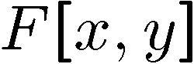
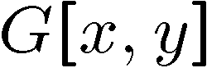
Mean filtering
0 | 0 | 0 | 0 | 0 | 0 | 0 | 0 | 0 | 0
0 | 0 | 0 | 0 | 0 | 0 | 0 | 0 | 0 | 0
0 | 0 | 0 | 90 | 90 | 90 | 90 | 90 | 0 | 0
0 | 0 | 0 | 90 | 90 | 90 | 90 | 90 | 0 | 0
0 | 0 | 0 | 90 | 90 | 90 | 90 | 90 | 0 | 0
0 | 0 | 0 | 90 | 0 | 90 | 90 | 90 | 0 | 0
0 | 0 | 0 | 90 | 90 | 90 | 90 | 90 | 0 | 0
0 | 0 | 0 | 0 | 0 | 0 | 0 | 0 | 0 | 0
0 | 0 | 90 | 0 | 0 | 0 | 0 | 0 | 0 | 0
0 | 0 | 0 | 0 | 0 | 0 | 0 | 0 | 0 | 0
Notes:
Replace each pixel with the average of a kxk window around it

Slide 30
Notes:
Move around over previous slide

Slide 31
Mean filtering
0 | 0 | 0 | 0 | 0 | 0 | 0 | 0 | 0 | 0
0 | 0 | 0 | 0 | 0 | 0 | 0 | 0 | 0 | 0
0 | 0 | 0 | 90 | 90 | 90 | 90 | 90 | 0 | 0
0 | 0 | 0 | 90 | 90 | 90 | 90 | 90 | 0 | 0
0 | 0 | 0 | 90 | 90 | 90 | 90 | 90 | 0 | 0
0 | 0 | 0 | 90 | 0 | 90 | 90 | 90 | 0 | 0
0 | 0 | 0 | 90 | 90 | 90 | 90 | 90 | 0 | 0
0 | 0 | 0 | 0 | 0 | 0 | 0 | 0 | 0 | 0
0 | 0 | 90 | 0 | 0 | 0 | 0 | 0 | 0 | 0
0 | 0 | 0 | 0 | 0 | 0 | 0 | 0 | 0 | 0
 | 0 | 10 | 20 | 30 | 30 | 30 | 20 | 10
 | 0 | 20 | 40 | 60 | 60 | 60 | 40 | 20
 | 0 | 30 | 60 | 90 | 90 | 90 | 60 | 30
 | 0 | 30 | 50 | 80 | 80 | 90 | 60 | 30
 | 0 | 30 | 50 | 80 | 80 | 90 | 60 | 30
 | 0 | 20 | 30 | 50 | 50 | 60 | 40 | 20
 | 10 | 20 | 30 | 30 | 30 | 30 | 20 | 10
 | 10 | 10 | 10 | 0 | 0 | 0 | 0 | 0
Notes:
Replace each pixel with the average of a kxk window around it
What happens if we use a larger filter window?

Slide 32
Effect of mean filters
Notes:
Demo with photoshop

Slide 33
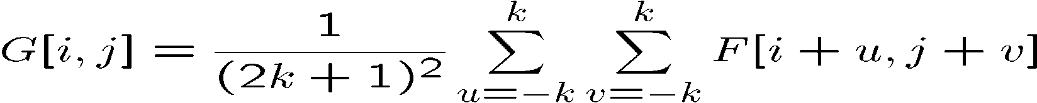
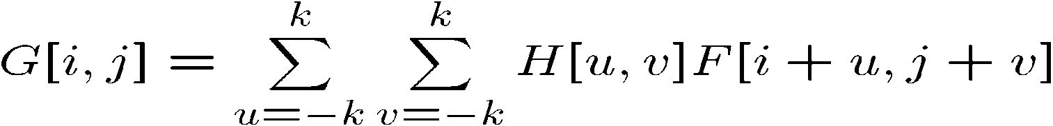
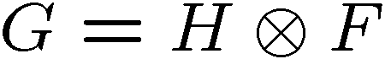
Cross-correlation filtering
Let’s write this down as an equation. Assume the averaging window is (2k+1)x(2k+1):
We can generalize this idea by allowing different weights for different neighboring pixels:
This is called a cross-correlation operation and written:
H is called the “filter,” “kernel,” or “mask.”
The above allows negative filter indices. When you implement need to use: H[u+k,v+k] instead of H[u,v]

Slide 34
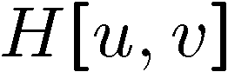
Mean kernel
What’s the kernel for a 3x3 mean filter?
0 | 0 | 0 | 0 | 0 | 0 | 0 | 0 | 0 | 0
0 | 0 | 0 | 0 | 0 | 0 | 0 | 0 | 0 | 0
0 | 0 | 0 | 90 | 90 | 90 | 90 | 90 | 0 | 0
0 | 0 | 0 | 90 | 90 | 90 | 90 | 90 | 0 | 0
0 | 0 | 0 | 90 | 90 | 90 | 90 | 90 | 0 | 0
0 | 0 | 0 | 90 | 0 | 90 | 90 | 90 | 0 | 0
0 | 0 | 0 | 90 | 90 | 90 | 90 | 90 | 0 | 0
0 | 0 | 0 | 0 | 0 | 0 | 0 | 0 | 0 | 0
0 | 0 | 90 | 0 | 0 | 0 | 0 | 0 | 0 | 0
0 | 0 | 0 | 0 | 0 | 0 | 0 | 0 | 0 | 0
Notes:
ones, divide by 9

Slide 35
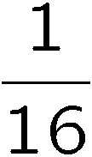
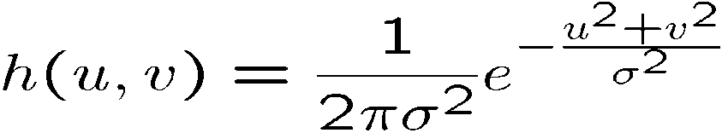
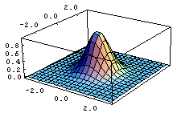
Gaussian Filtering
A Gaussian kernel gives less weight to pixels further from the center of the window
This kernel is an approximation
of a Gaussian function:
0 | 0 | 0 | 0 | 0 | 0 | 0 | 0 | 0 | 0
0 | 0 | 0 | 0 | 0 | 0 | 0 | 0 | 0 | 0
0 | 0 | 0 | 90 | 90 | 90 | 90 | 90 | 0 | 0
0 | 0 | 0 | 90 | 90 | 90 | 90 | 90 | 0 | 0
0 | 0 | 0 | 90 | 90 | 90 | 90 | 90 | 0 | 0
0 | 0 | 0 | 90 | 0 | 90 | 90 | 90 | 0 | 0
0 | 0 | 0 | 90 | 90 | 90 | 90 | 90 | 0 | 0
0 | 0 | 0 | 0 | 0 | 0 | 0 | 0 | 0 | 0
0 | 0 | 90 | 0 | 0 | 0 | 0 | 0 | 0 | 0
0 | 0 | 0 | 0 | 0 | 0 | 0 | 0 | 0 | 0
1 | 2 | 1
2 | 4 | 2
1 | 2 | 1

Slide 36
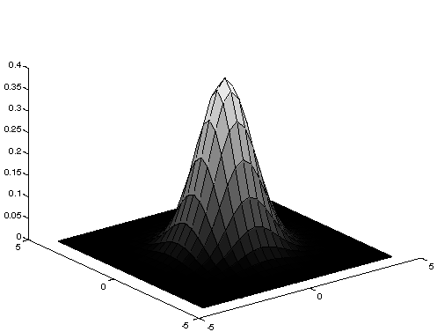
Gaussian Averaging
Rotationally symmetric.
Weights nearby pixels more than distant ones.
This makes sense as probabilistic inference.
A Gaussian gives a good model of a fuzzy blob

Slide 37
An Isotropic Gaussian
The picture shows a smoothing kernel proportional to
(which is a reasonable model of a circularly symmetric fuzzy blob)

Slide 38
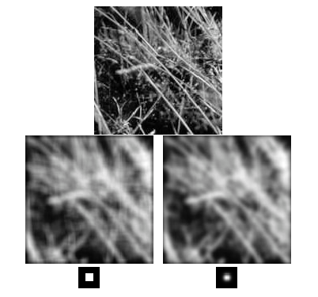
Mean vs. Gaussian filtering

Slide 39
Efficient Implementation
Both, the BOX filter and the Gaussian filter are separable:
First convolve each row with a 1D filter
Then convolve each column with a 1D filter.

Slide 40
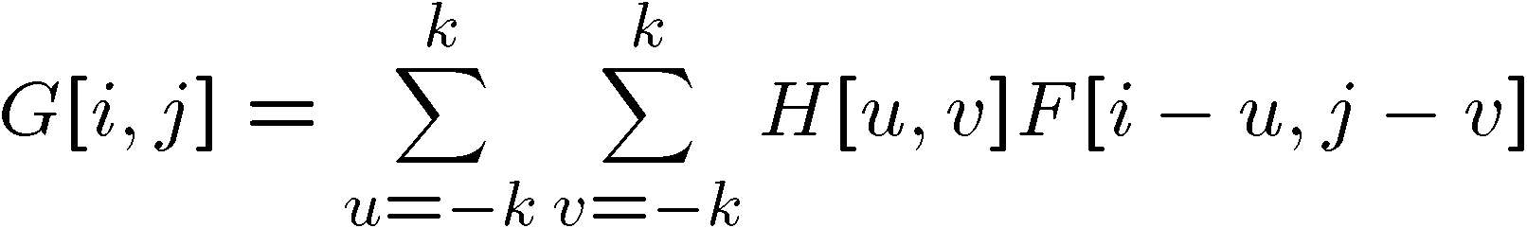

Convolution
A convolution operation is a cross-correlation where the filter is flipped both horizontally and vertically before being applied to the image:
It is written:
Suppose H is a Gaussian or mean kernel. How does convolution differ from cross-correlation?
Notes:
They are the same for filters that have both horizontal and vertical symmetry.

Slide 41
Linear Shift-Invariance
A tranform T{} is
Linear if:
T(a g(x,y)+b h(x,y)) = a T{g(x,y)} + b T(h(x,y))
Shift invariant if:
Given T(i(x,y)) = o(x,y)
T{i(x-x0, y- y0)} = o(x-x0, y-y0)

Slide 42
Median filters
A Median Filter operates over a window by selecting the median intensity in the window.
What advantage does a median filter have over a mean filter?
Is a median filter a kind of convolution?
Median filter is non linear
Notes:
Better at salt’n’pepper noise
Not convolution: try a region with 1’s and a 2, and then 1’s and a 3

Slide 43
Comparison: salt and pepper noise

Slide 44
Comparison: Gaussian noise

Slide 45
Fourier Series
Analytic geometry gives a coordinate
system for describing geometric objects.
(x,y) = x(1,0) + y (0,1)
(1,0) and (0,1) form an orthonormal basis for the plane. That means they are orthogonal – their inner product <(1,0), (0,1)> = 0, and of unit magnitude.
Fourier Series gives a coordinate system for functions.

Slide 46
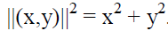
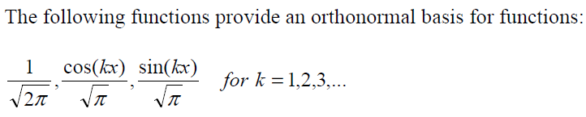
Why is an orthonormal basis a good representation?
Projection. To find the x coordinate, we take <(x,y), (1,0)>.
Pythagorean theorem.

Slide 47
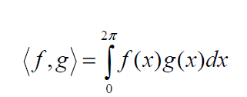
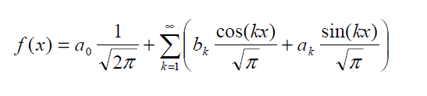
What is the inner product for functions
With discrete vectors, to compute the inner product we multiply together the values of matching coordinates, and then add up the results. We do the same thing with continuous functions; we multiply them together, and integrate (add) the result.

Slide 48
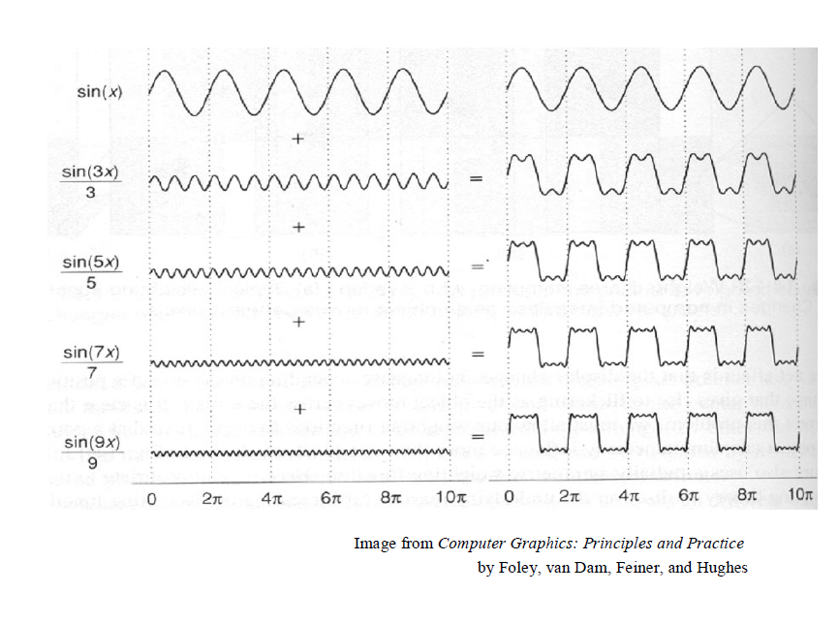

Slide 49
Fourier
Values (a0, b1, a1, b2, a2, …) are the coordinates of the function in this new coordinate system provided by the Fourier Series.

Slide 50
What does this mean?
This result means that any function can be broken down into:
the sum of sine waves of different amplitudes and phases.
We say that the part of the function that is due to longer frequency sine waves is the low frequency part of the function. The part that is due to high frequency sine waves is the high frequency component of the function.
If a function is very bumpy, with small rapid changes in its value, these rapid changes will be due to the high frequency component of the function. If we can eliminate these high-frequency components, we can make the function smoother.

Slide 51
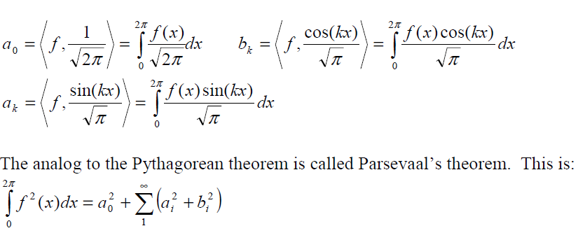
Solving for the coordinates

Slide 52
Convolution Theorem
Let F, G, H be the Fourier series that represents the functions f, g, and h. That is, F,G, and H are infinite vectors. The convolution theorem states that convolution in the spatial domain is equivalent to component-wise multiplication in the transform domain

Slide 53
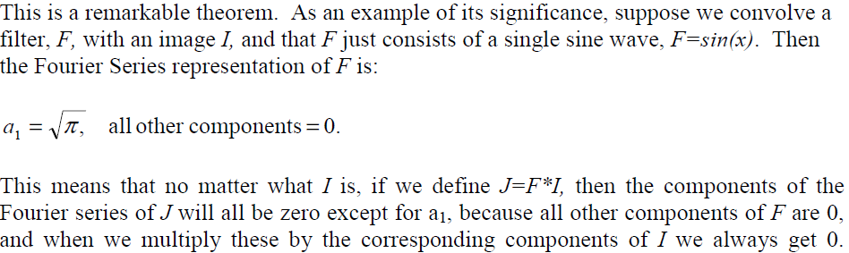
Consequences of the Theorem

Slide 54
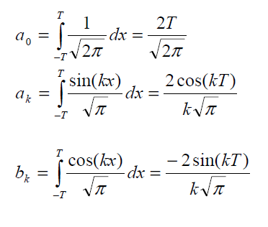
Why averaging is not a good way to smooth
Let f(x) be an averaging filter, which is constant in the range –T to T. Then, we can compute its Fourier Series as:

Slide 55
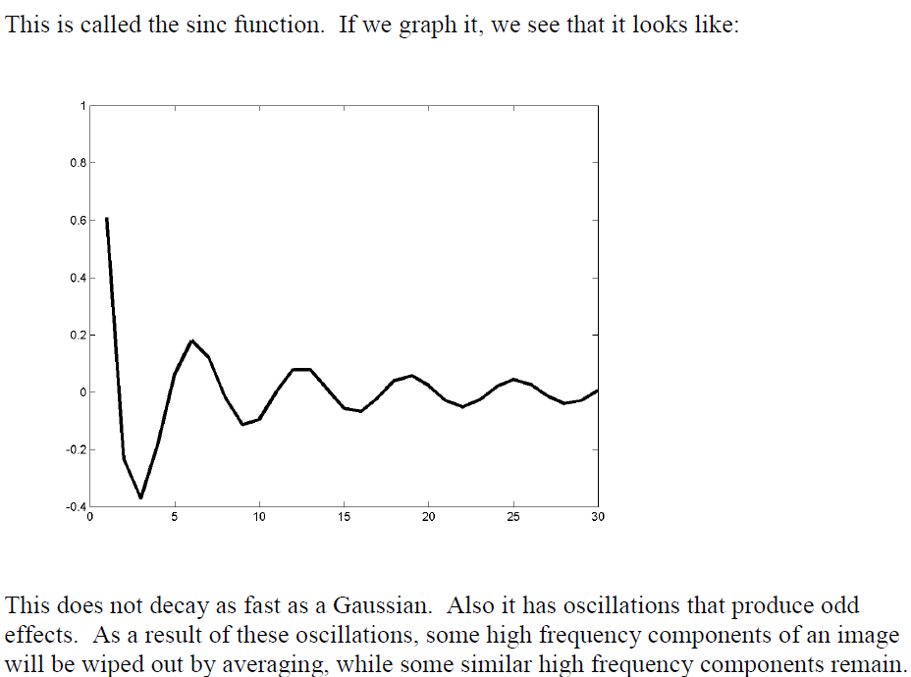

Slide 56
The Fourier Series of a Gaussian
the Fourier series representation of a Gaussian is also a Gaussian. If g(t) is a Gaussian, the broader g is, the narrower G is (and vice versa). This means that smoothing with a Gaussian reduces high frequency components of a signal.

Slide 57
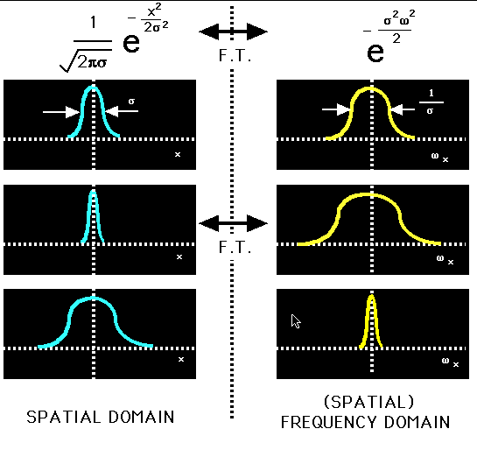

Slide 58
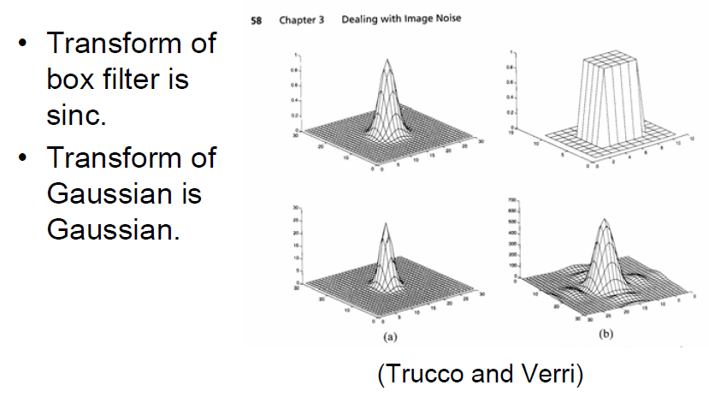

Slide 59
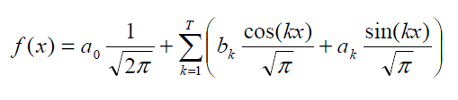
Aliasing and Sampling Theorem
Sampling means that we know the value of a function, f, at discrete intervals, f(nπ/T) for n = 0, +-1, +-T. That is, we have 2T + 1 uniform samples of f(x), assuming f is a periodic function
Suppose f is band limited to T, i.e.
We know the value of f(x) at 2T + 1 positions. If we plug these values into the above equation, we get 2T + 1 equations. The ai and bi give us 2T + 1 unknowns. These are linear equations. So we get a unique solution. This means that we can reconstruct f from its samples. However, if we have fewer samples, reconstruction is not possible. If there is a higher frequency component, then this can play havoc with our reconstruction of all low frequency components, and be interpreted as odd low frequency components.

